Slide 1


“Journey from Beginner to Expert”
with
Python
By
Rohit Kumar
Project Manager

Slide 2
Technology Experience
5+ years experience in Web Development and Database Administration.
Programming Languages :- C, C++, Java, Python, VB.
Web Technologies :- HTML5, CSS3, Java Script, JQuery, JSP, PHP
Database Applications :- Oracle, MYSQL
Platforms :- Windows , Unix
Frameworks :- Code Ignitor, Cake PHP etc….
CMS :- Wordpress, Joomla, Magento, Drupal etc…

Slide 3


Establishment | 1994
Turnover | 1000 Million/Anum.
Branches | Lucknow , Sitarganj, Haldwani, Ludhiana etc.
Operation | KARAM is India’s leading Personal Protective Equipment Manufacturing enterprise, and is rated as one of the finest Indian companies providing world class PPE. KARAM ranks as the number one Company in the field of Personal Safety in the country, and as one of the top ten Fall Protection manufacturing companies in the World.

Slide 4
I got a call from IT department of KARAM asking us for a solution to a very common Issue.
“Productivity Monitoring & Wage calculation of workers.”
The Solution to this problem was calculating the Real – Time output of workers working
on PLC based devices and setting their wages accordingly.
Database
PLC based devices
Capture Input
Internet
HRMS
Raspberry Pi Python

Slide 5
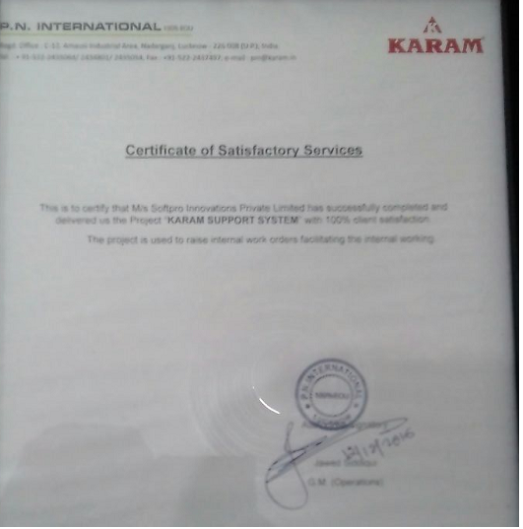

Slide 6
How Python became No. 1 in
Current Scenario?

Slide 7
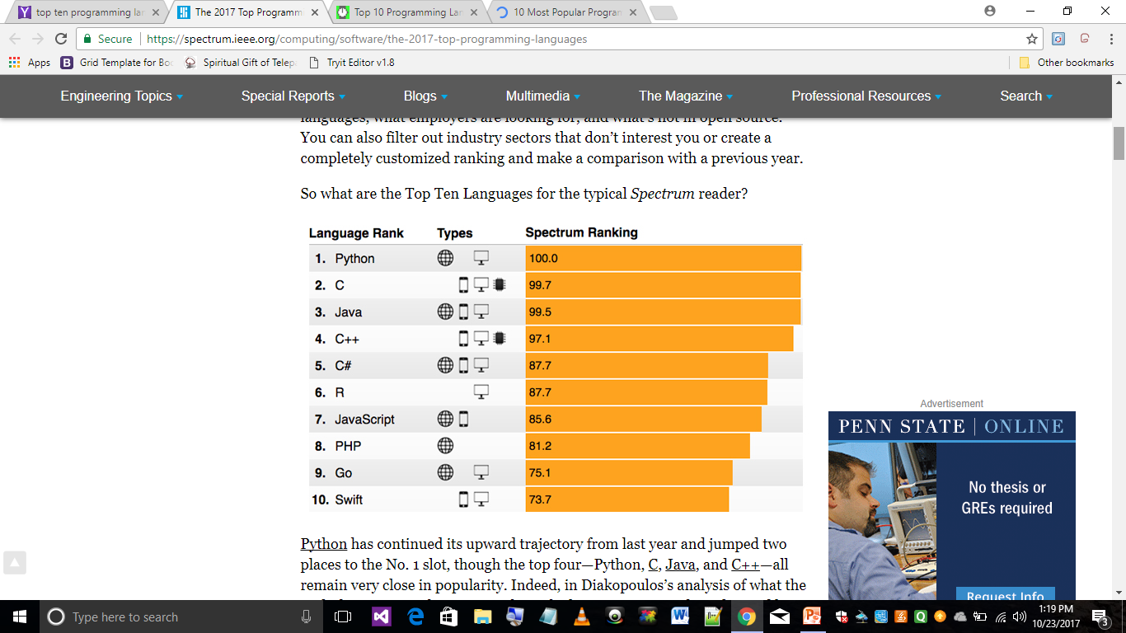

Slide 8
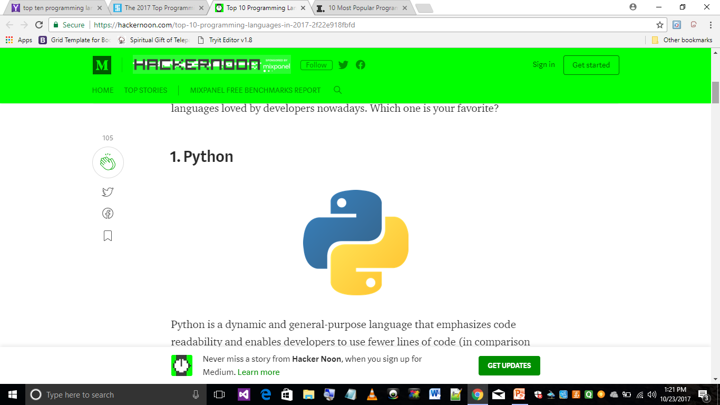

Slide 9
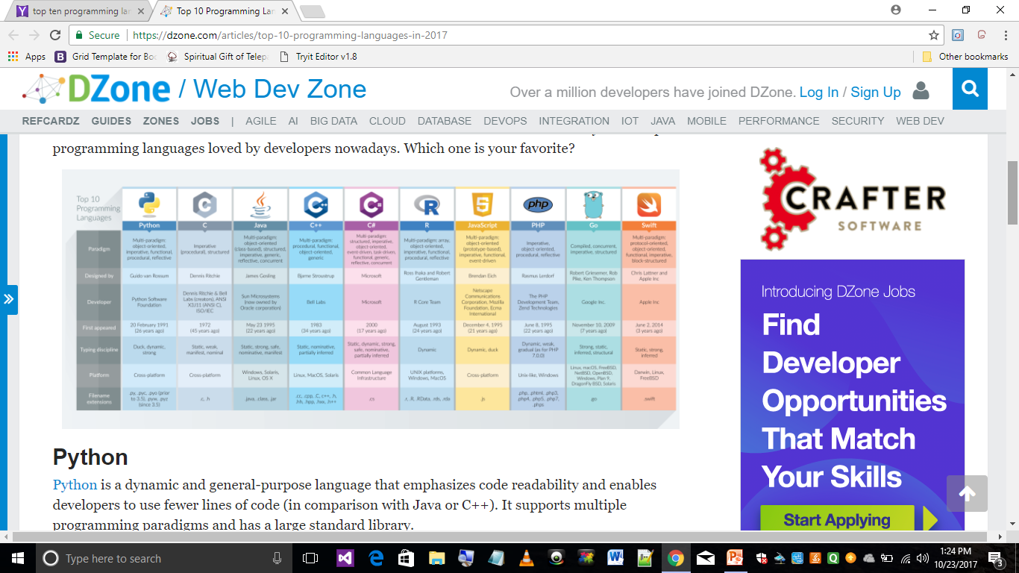

Slide 10
Software Industry
Desktop Applications
Web Applications
Hardware Industry
Embedded System
Robotics
Python Applications
Automation
Industrial Automation
Home Automation
Vehicle Automation

Slide 11
Industrial Applications of Python

Slide 12
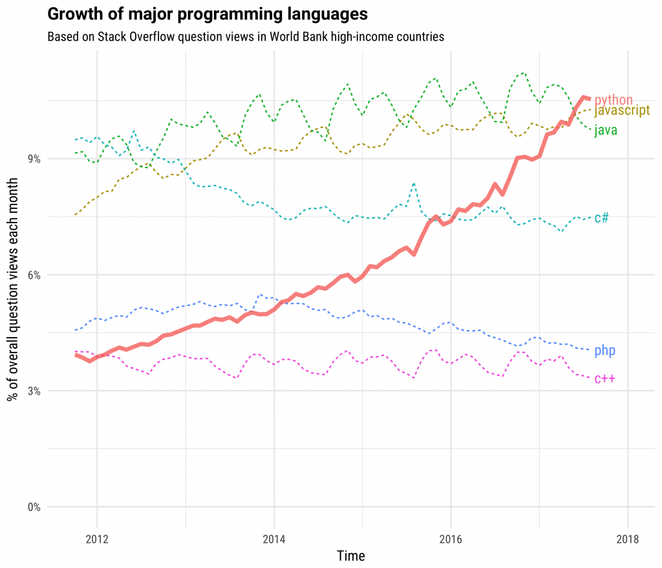
Growth Wise

Slide 13
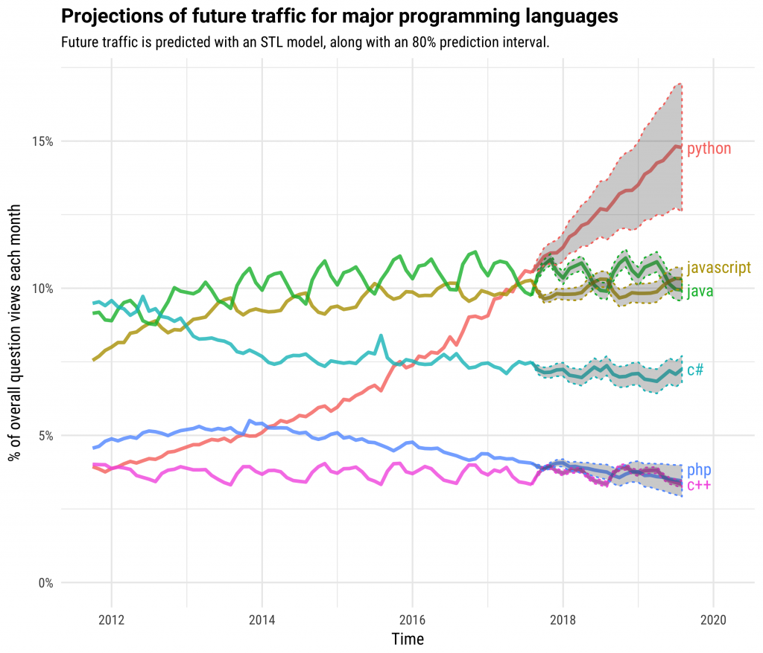
Growth Wise

Slide 14
Hardware Application of Python

Slide 15
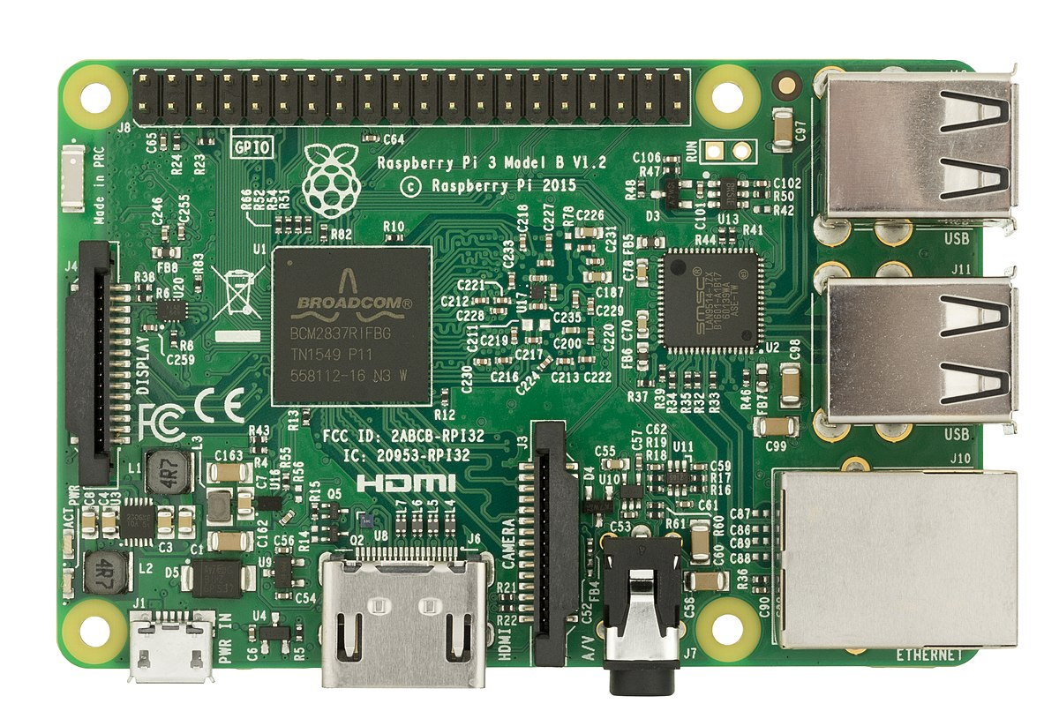
Raspberry Pi

Slide 16
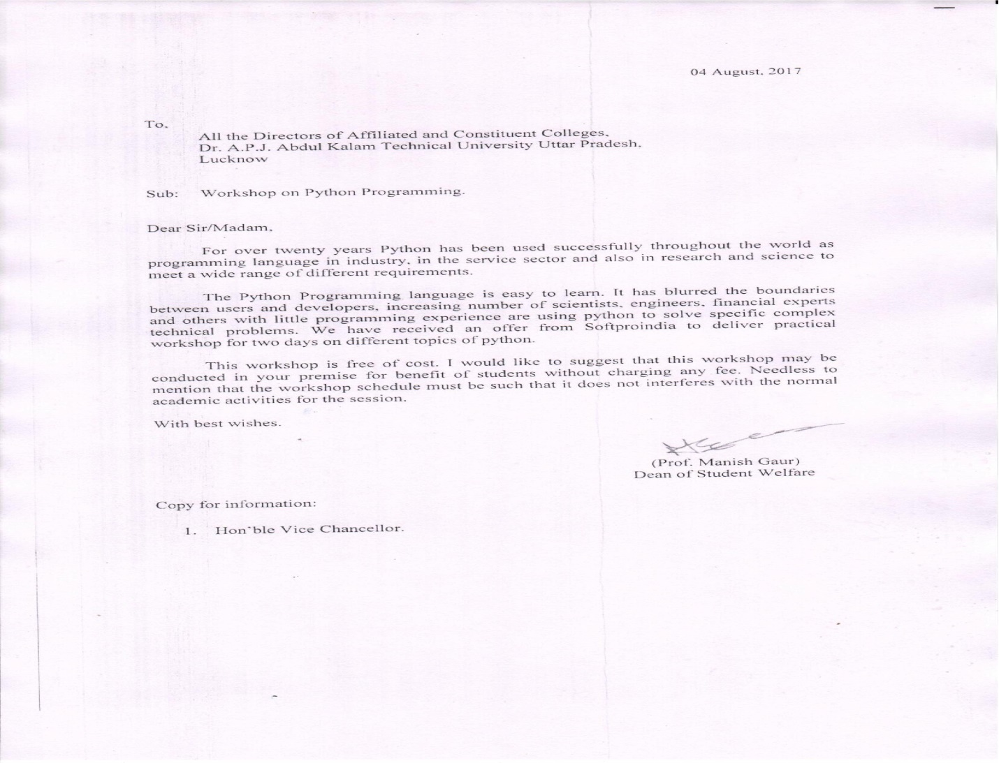
We are the first company to introduce Python in AKTU (One of the Largest Technical University in Asia).

Slide 17
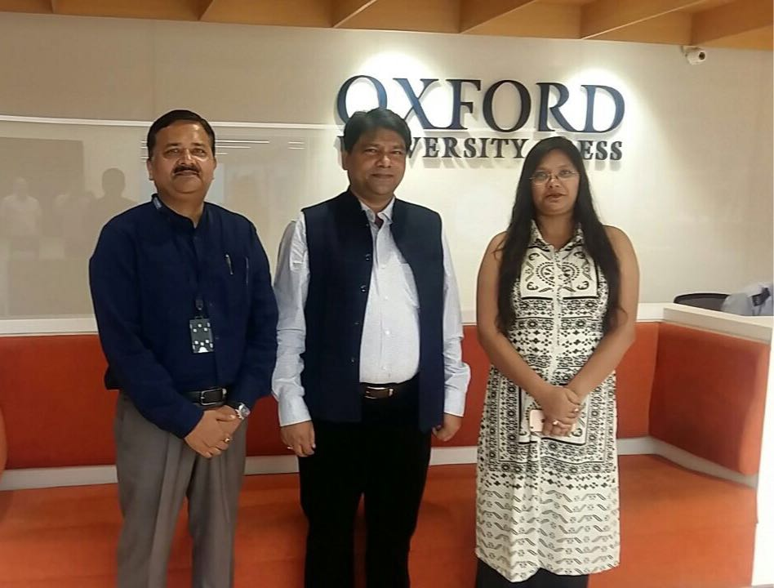
Association with one of the World’s no. 1 content development company (publisher) to spread Python learning.
Mr. Paras Bansal (Manager ,OUP) is with Er. Ajay Chaudhary (Director Softpro Group) and Ms. Yashi Asthana (CEO Softpro Group)
OXFORD University Press

Slide 18

How Python got associated with Future Technology (IOT)?
The Internet of Things (IoT) is the network of physical objects—devices, vehicles, buildings and other items embedded with electronics, software, sensors, and network connectivity—that enables these objects to collect and exchange data.
Where is IOT ?………………………… It’s every where !

Slide 19
IOT
Various Names, One Concept
M2M (Machine to Machine)
“Internet of Everything” (Cisco Systems)
“World Size Web” (Bruce Schneier)
“Skynet” (Terminator movie)

Slide 20

Types of Computer Languages

Slide 21
Languages of Computer
Markup Languages | Programming Languages | Scripting Languages | Database Languages
HTML | C | Java Script | SQL
XML | C++ | VB Script | PL/SQL
DHTML | Java | PHP
 | C#
 | Python
 | Fortron
 | Pascal

Slide 22

What is Python?
Python is an interpreted, object-oriented, high-level programming language with dynamic semantics.
Guido Van Rossum

Slide 23
Features of Python
Less line of codes than other languages.
Platform independent
Open Source
Object Oriented
It supports functional and structured programming methods .
It provides very high-level dynamic data types and supports dynamic type checking.
It supports automatic garbage collection.
It can be easily integrated with C, C++, COM, ActiveX and Java.

Slide 24
Comparison of Languages

Slide 25
To make simple calculator, code written in java
import java.util.*;
class SimpleCalc
{
public static void main(String [] args)
{
Scanner sc=new Scanner(System.in);
System.out.println(“Enter two numbers”);
int a,b;
a=sc.nextInt();
b=sc.nextInt();
System.out.println(“Summation = ”+(a+b));
System.out.println(“Subtraction = ”+(a-b));
System.out.println(“Multiplication = ”+(a*b));
System.out.println(“Division = ”+(a/b));
}
}
Total line of codes = 17

Slide 26
To make simple calculator, code written in C#
using System;
class SimpleCalc
{
public static void Main(String [] args)
{
Console.WriteLine(“Enter two numbers”);
int a,b;
a=int.Parse(Console.ReadLine());
b=int.Parse(Console.ReadLine());
Console.WriteLine(“Summation = ”+(a+b));
Console.WriteLine(“Subtraction = ”+(a-b));
Console.WriteLine(“Multiplication = ”+(a*b));
Console.WriteLine(“Division = ”+(a/b));
}
}
Total line of codes = 15

Slide 27
To make simple calculator, code written in Python
a=input(“Enter first number : ”)
b=input(“Enter second number : ”)
print “Summation =”,(a+b)
print “Subtraction=”,(a-b)
print “Multiplication =”,(a*b)
print “Division =”,(a/b)
Total line of codes = 6

Slide 28
Companies using Python

Slide 29




















Slide 30
Let’s start our journey with Python

